Slide 1


Slide 2
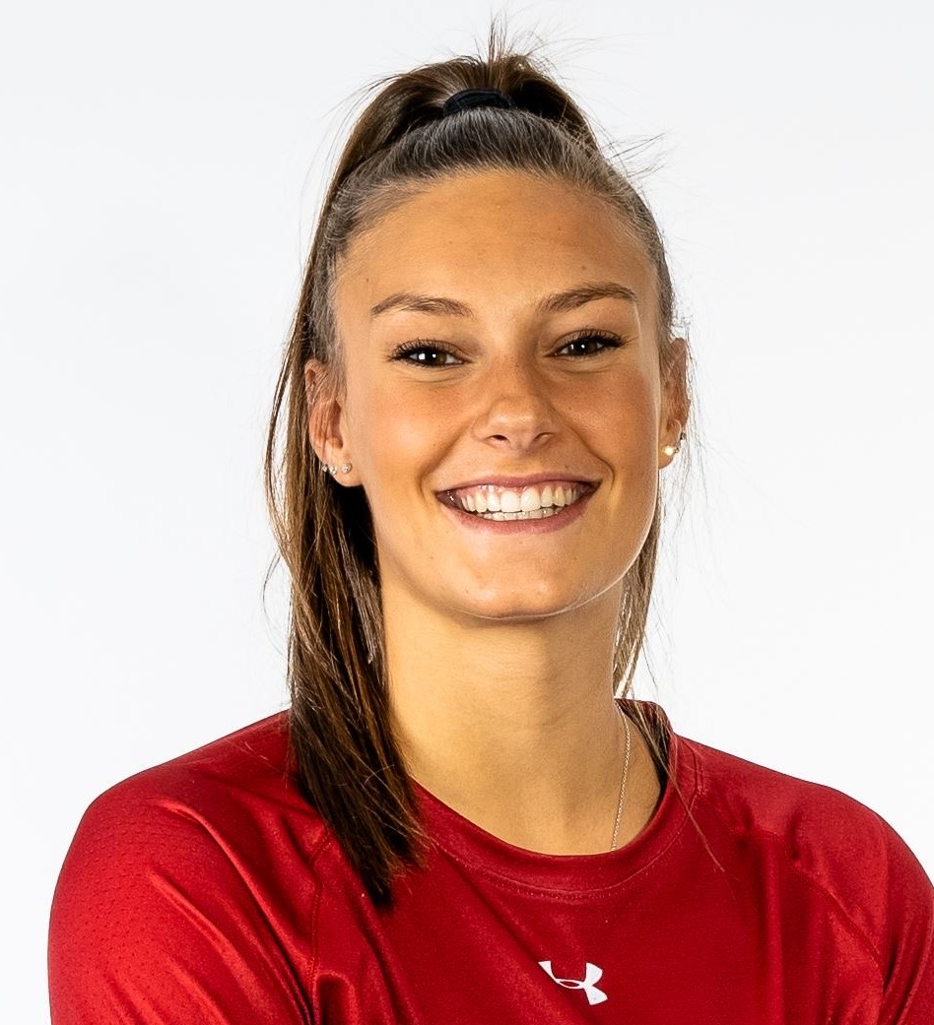
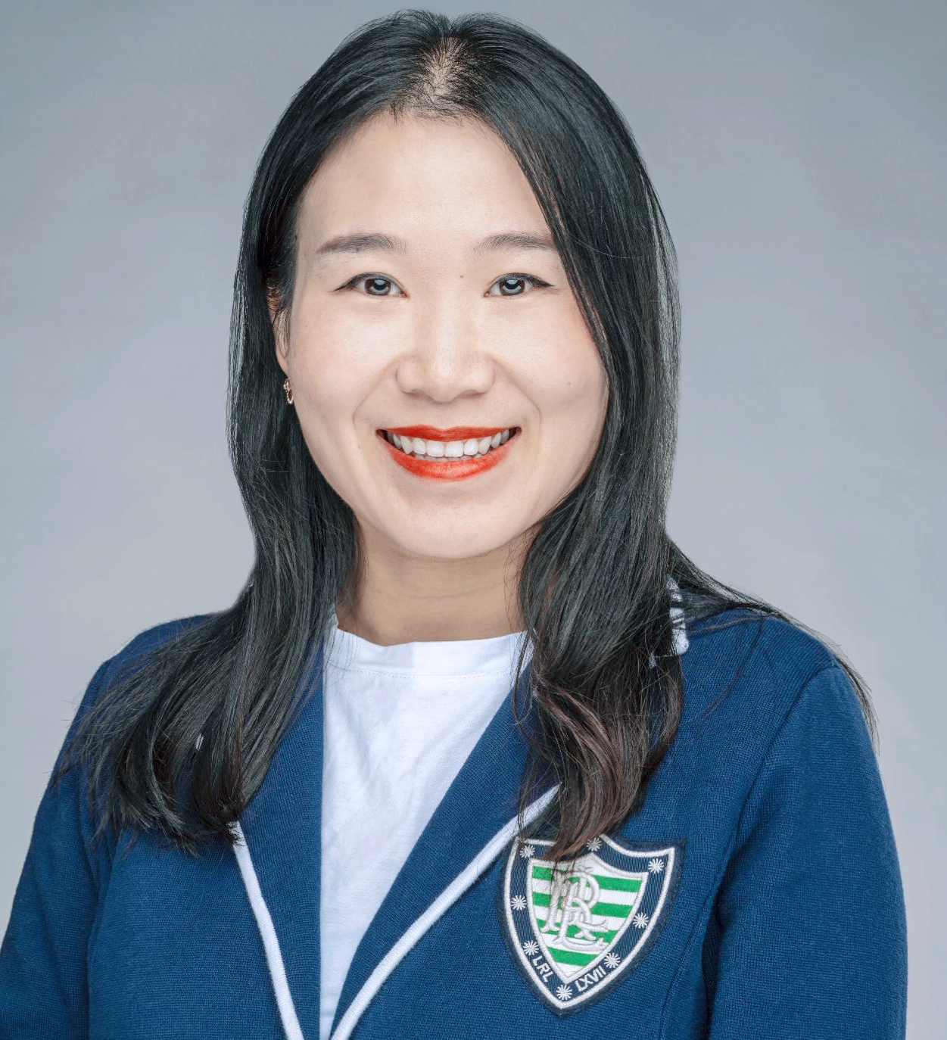
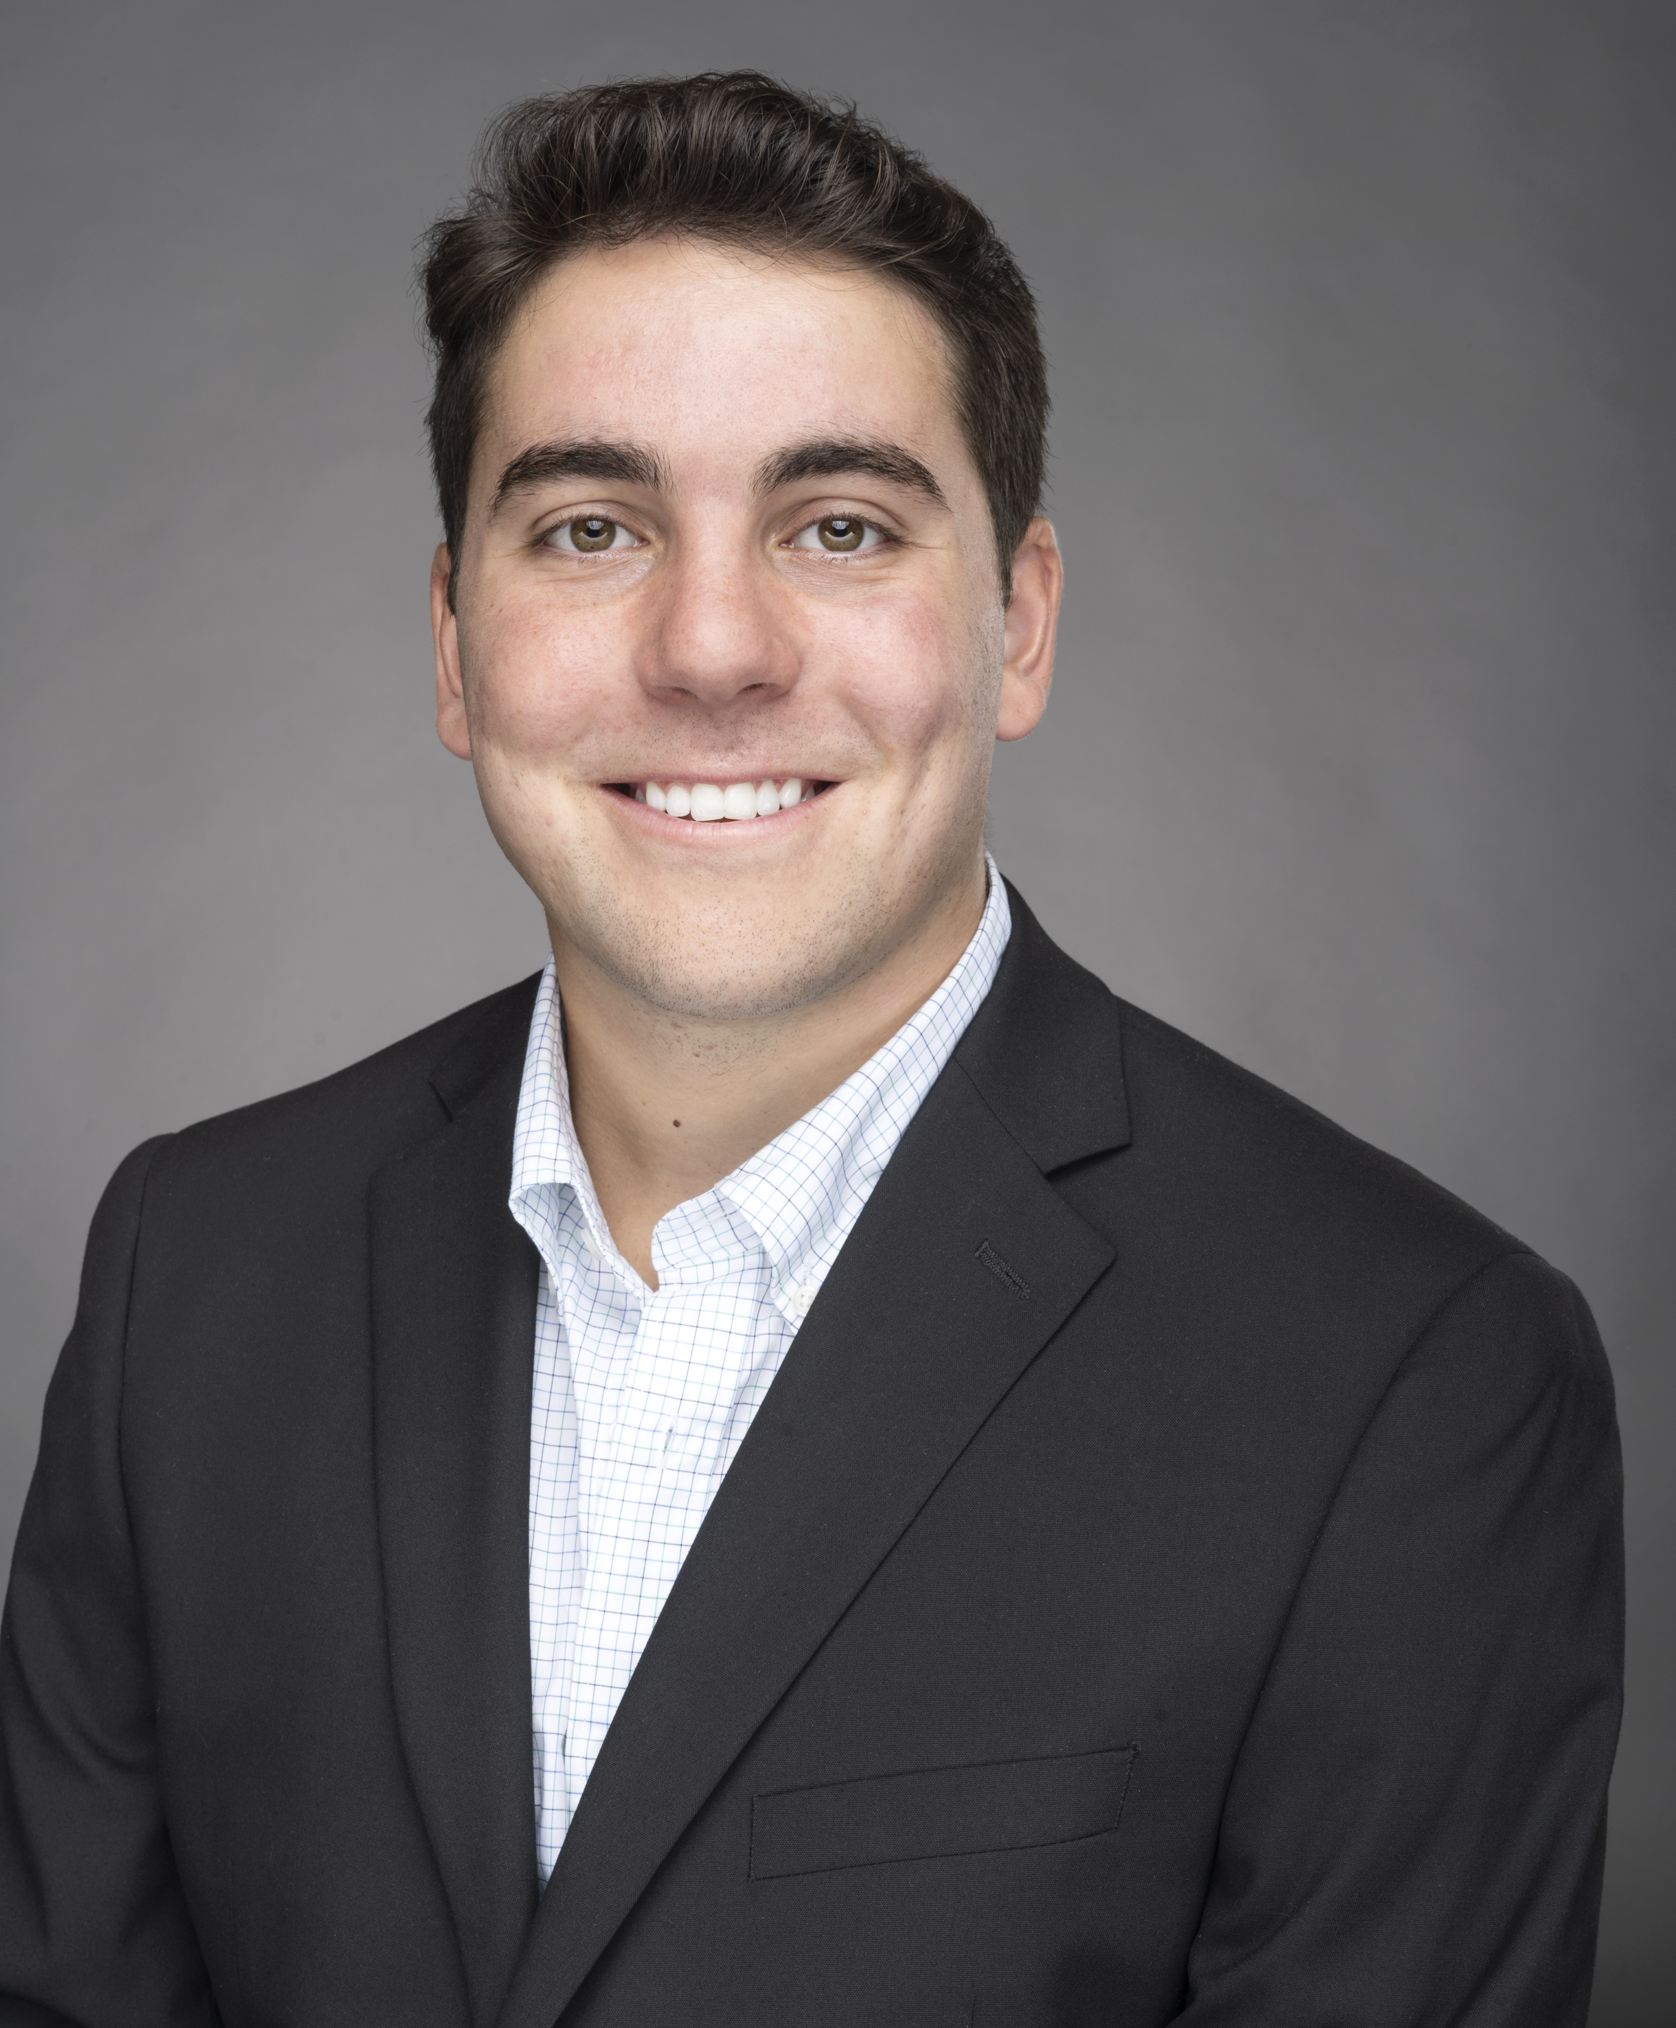
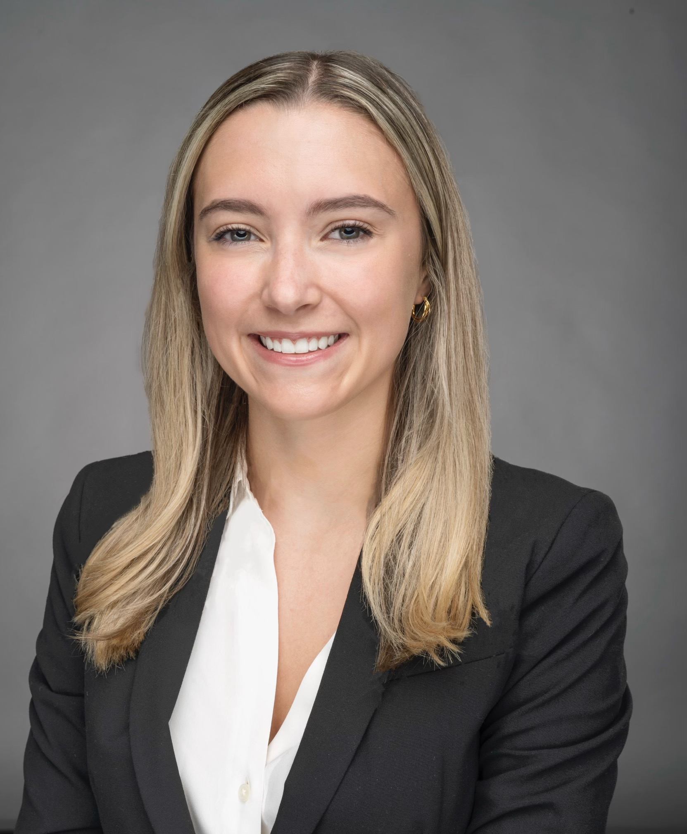

Meet Our Team
Master of Business Analytics Candidates Class of 2023
Izzy Ashburn
BS Mathematics
UW-Madison
Jian Li
Juris Master
BS Economics
BS Medicine
Peking University, China
Toby Nabavian
BBA Finance
UW-Madison
Jillian Wedin BBA Finance
UW-Madison
Shivkumar Umadi
BS Engineering
Bangalore, India

Slide 3

Our Objective

Slide 4


The Question Behind Our Analysis
Objective
Build a predictive model to determine customers’ propensity to belong to a cluster based on the third-party data
Question
What is the best model for propensity scoring?

Slide 5



Why Does This Matter?
Use Cases
Marketing &
E-Commerce
Targeted and personalized campaigns and messaging
Product Recommendations
Increased engagement and conversion rates
Customer
Lifetime Value
Optimize customer acquisitions and retention

Slide 6

Our Recommendation

Slide 7
Using the Funnel Method to Predict Clusters
Cluster 0
Cluster 2
Cluster 5
% of Total
53.61%
19.87%
15.12%
Model Type
Decision Tree
Decision Tree
Gradient Boost
Accuracy*
96.98%
96.99%
97.96%
Note: * denotes accuracy based on the misclassification rate
Notes:
→ This is based on the entire data set

Slide 8
Using the Funnel Method to Predict Clusters
Cluster 4
Cluster 3
Cluster 1
% of Total
6.51%
4.50%
0.005%
Model Type
Gradient Boost
Random Forest
N/A
Accuracy*
98.92%
98.94%
N/A
Note: * denotes accuracy based on the misclassification rate

Slide 9

Our Approach

Slide 10





Approach to Modeling Step-by-Step
Propensity Model Research
Data Cleaning & Exploration
Model Building Using Funnel Method
Model Validation & Assessment
Model Deployment to Use Case 1

Slide 11
Research

Slide 12





Propensity Modeling is Segmentation Estimation
Propensity Modeling
A propensity score is a probabilistic estimation of whether the customer will perform a certain action again or not
Recommended Models
Propensity models perform well for predicting probability of a given segment
Logistic regression, Random forests, Neural networks, Gradient Boosting
Use Cases
Optimize marketing and sales strategies
Offer personalized product recommendations to drive sales
Research
Clean
Build
Validate
Deploy
Source: Multivariate Behavior Research. 2011 May; 46(3): 399–424.

Slide 13
Cleaning & Exploration

Slide 14


Data Cleaning is Essential to Predictive Accuracy
Random Sampling
Concatenating
Data Cleaning
Consumer Behavior Sample File
1
From 40 Consumer Files
Examine NA Values
Imputation
Feature removal
customer_id
Pull 25k Random Records
2
Eliminate Duplicates
3
1m Record Sample
Cluster File
Eliminate Erroneous Values
Research
Clean
Build
Validate
Deploy

Slide 15

Geographic Distribution

Slide 16
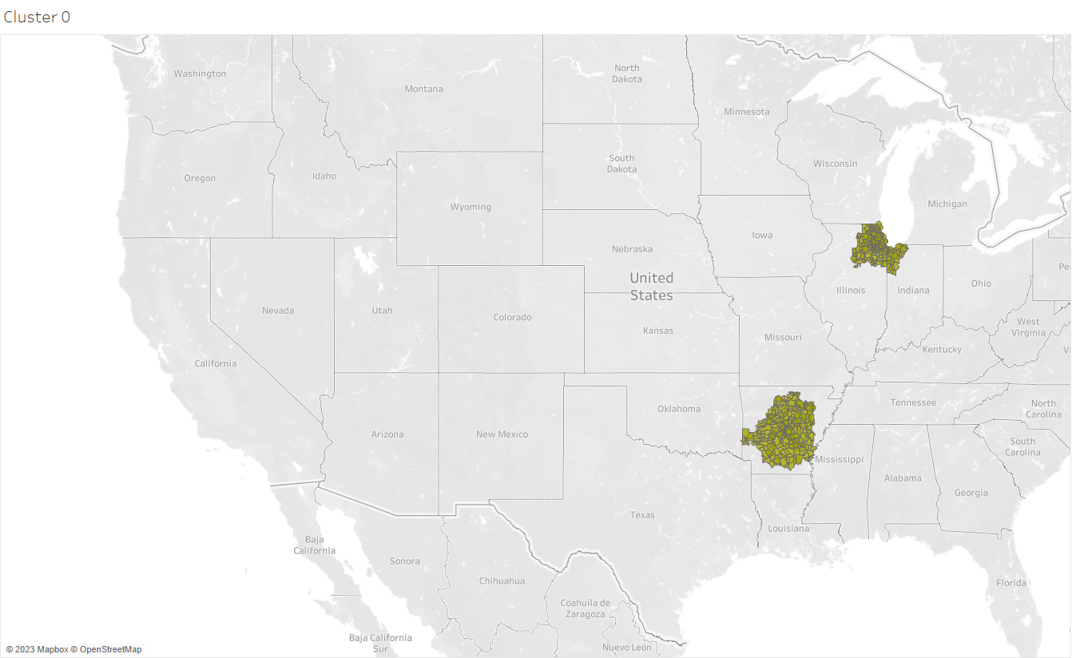
Cluster 0 is Present in Arkansas and Illinois
Research
Clean
Build
Validate
Deploy
Source: Multivariate Behavior Research. 2011 May; 46(3): 399–424.

Slide 17
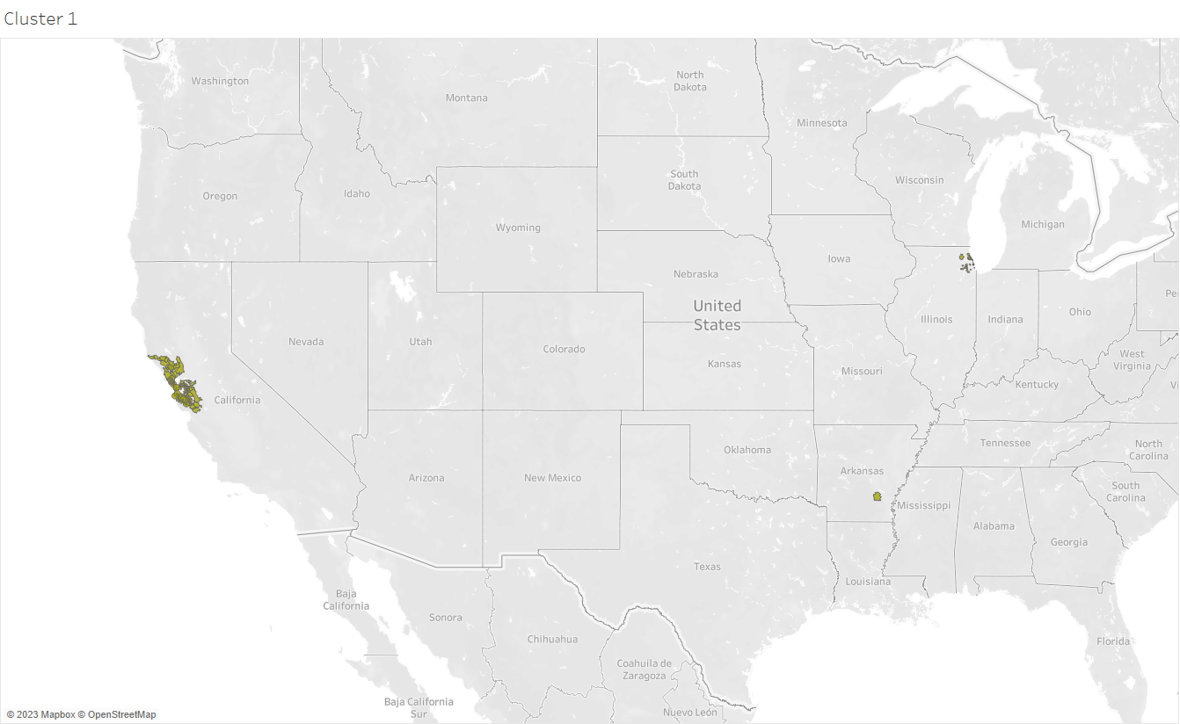
Cluster 1 is Primarily in California
Research
Clean
Build
Validate
Deploy
Source: Multivariate Behavior Research. 2011 May; 46(3): 399–424.

Slide 18
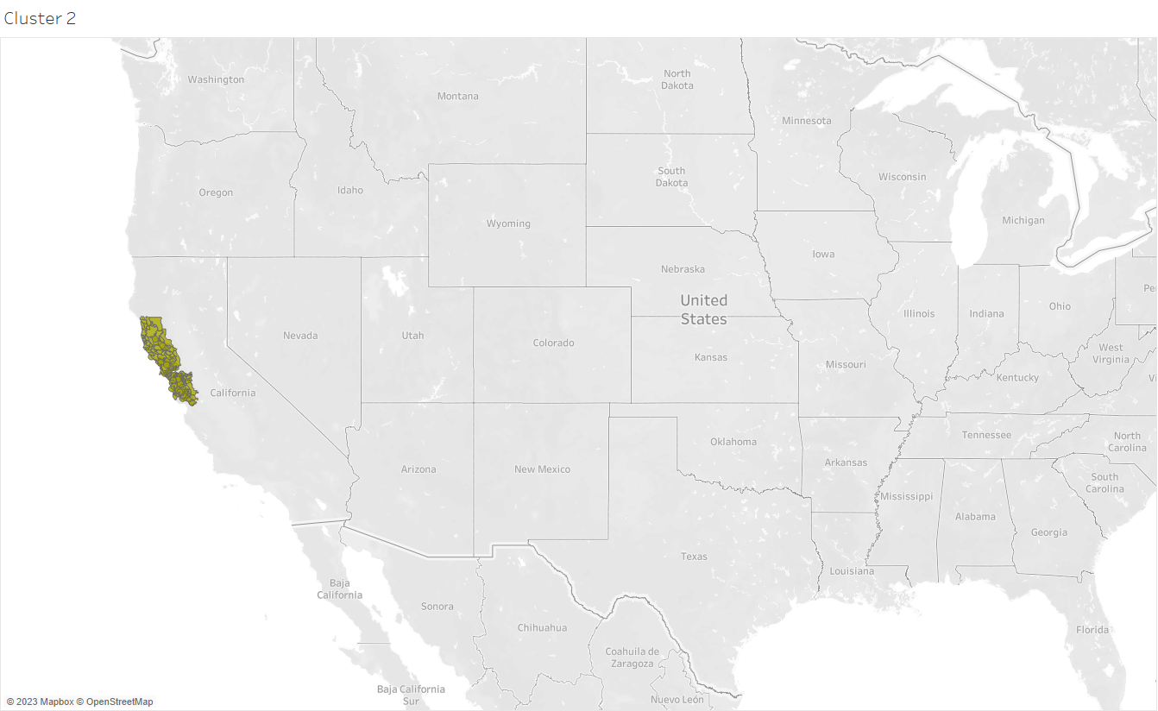
Cluster 2 is Present in California
Research
Clean
Build
Validate
Deploy
Source: Multivariate Behavior Research. 2011 May; 46(3): 399–424.

Slide 19
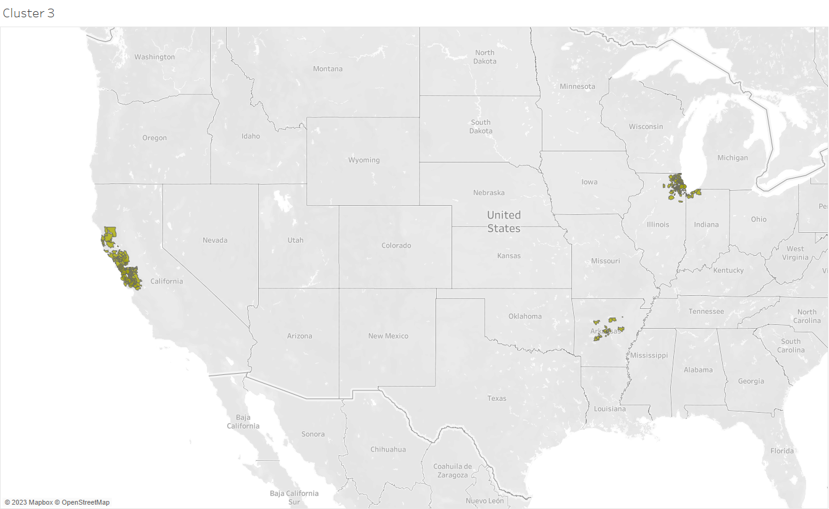
Cluster 3 is Present in All Three Regions
Research
Clean
Build
Validate
Deploy
Source: Multivariate Behavior Research. 2011 May; 46(3): 399–424.

Slide 20
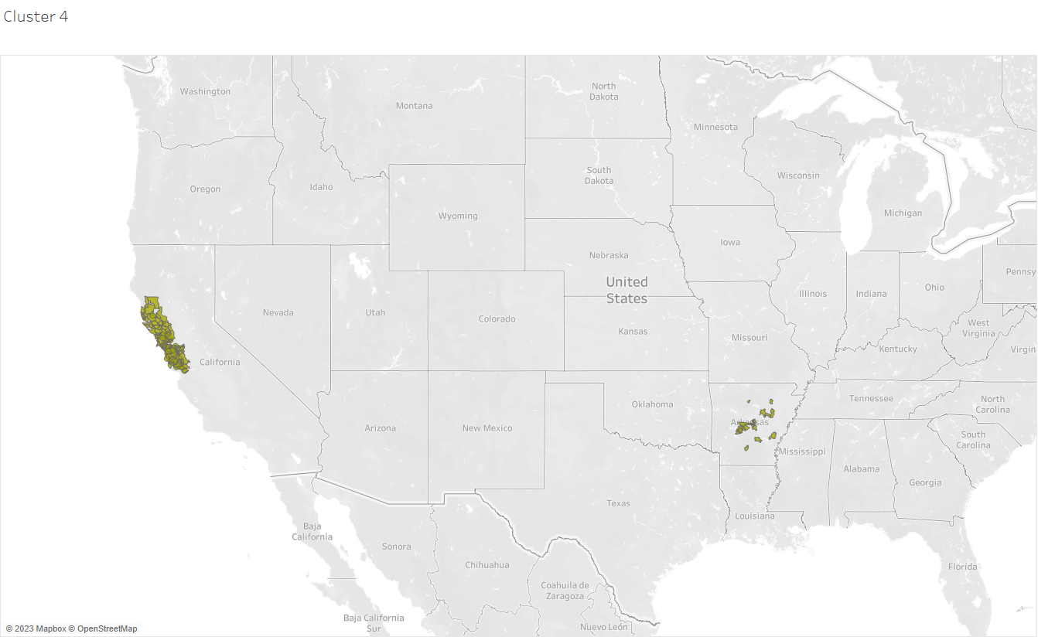
Cluster 4 is Present in California and Arkansas
Research
Clean
Build
Validate
Deploy
Source: Multivariate Behavior Research. 2011 May; 46(3): 399–424.

Slide 21
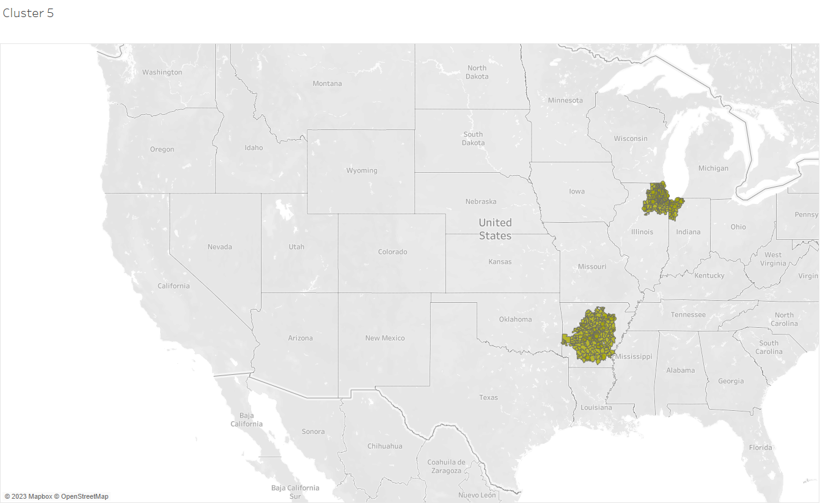
Cluster 5 is Present in Arkansas and Illinois
Research
Clean
Build
Validate
Deploy
Source: Multivariate Behavior Research. 2011 May; 46(3): 399–424.

Slide 22
Customer Profiling

Slide 23

Cluster 0 is Elderly, Price Sensitive Females
Age: 65+
Education: HS Degree
Ethnicity: Caucasian
Income: $41k - $60k
Gender: Female
Discretionary Spend: Low
Research
Clean
Build
Validate
Deploy
Source: Multivariate Behavior Research. 2011 May; 46(3): 399–424.

Slide 24

Cluster 1 is Middle-Aged, Educated Big-Spenders
Age: 55 - 64
Education: Graduate Degree
Ethnicity: Caucasian
Income: $151k +
Gender: Male
Discretionary Spend: High
Research
Clean
Build
Validate
Deploy
Source: Multivariate Behavior Research. 2011 May; 46(3): 399–424.
Notes:
- This cluster is the biggest discretionary spender!!

Slide 25

Cluster 2 is Middle-Aged, Hispanic Males
Age: 55 - 64
Education: Bachelor Degree
Ethnicity: Hispanic
Income: $101k – $150k
Gender: Male
Discretionary Spend: Low
Research
Clean
Build
Validate
Deploy
Source: Multivariate Behavior Research. 2011 May; 46(3): 399–424.

Slide 26

Cluster 3 is Middle-Aged, Educated, Moderate Spenders
Age: 55 - 64
Education: Graduate Degree
Ethnicity: Caucasian
Income: $151k +
Gender: Male
Discretionary Spend: Moderate
Research
Clean
Build
Validate
Deploy
Source: Multivariate Behavior Research. 2011 May; 46(3): 399–424.

Slide 27

Cluster 4 is Middle-Aged, Moderate Spending Males
Age: 55 - 64
Education: Bachelor Degree
Ethnicity: Caucasian
Income: $151k +
Gender: Male
Discretionary Spend: Moderate
Research
Clean
Build
Validate
Deploy
Source: Multivariate Behavior Research. 2011 May; 46(3): 399–424.

Slide 28

Cluster 5 is Middle-Aged, Price Sensitive Males
Age: 55 - 64
Education: Bachelor Degree
Ethnicity: Caucasian
Income: $101k - $150k
Gender: Male
Discretionary Spend: Low
Research
Clean
Build
Validate
Deploy
Source: Multivariate Behavior Research. 2011 May; 46(3): 399–424.

Slide 29
The Biggest Differentiator between Clusters is Spend
Research
Clean
Build
Validate
Deploy

Slide 30
Model Building

Slide 31
The Funnel Approach Predicts in Order of Distribution
Cluster | Percentage
0 | 54%
2 | 20%
5 | 15%
4 | 7%
3 | 4%
1 | < 1%
Research
Clean
Build
Validate
Deploy

Slide 32


The Funnel Method Filters Data
Step 1
Step 2
Step 3
Step 4
Start with the entire dataset and fit several models to the first cluster
Use test set predictions to find the misclassification rate
Choose the model based on the best accuracy and predict for the entire dataset
Eliminate the records predicted into the cluster and repeat steps for new data subset
Research
Clean
Build
Validate
Deploy

Slide 33
Model Validation

Slide 34
Model Building for Cluster 0
Logistic Regression
Random Forest
Decision Tree
Gradient Boost
Neural Net
Confusion Matrix
37330 | 8968
6256 | 47446
46236 | 62
23 | 53679
46286 | 12
18 | 53684
69651 | 25
22 | 80302
44965 | 1
1409 | 53625
Accuracy*
84.78%
96.92%
96.98%
96.97%
96.59%
Research
Clean
Build
Validate
Deploy
Note: * denotes accuracy based on the misclassification rate
Notes:
Updated – decision tree wins (more simplified model)

Slide 35
Decision Tree is the Best Model for Cluster 0
Logistic Regression
Random Forest
Decision Tree
Gradient Boost
Neural Net
Confusion Matrix
37330 | 8968
6256 | 47446
46236 | 62
23 | 53679
46286 | 12
18 | 53684
69651 | 25
22 | 80302
44965 | 1
1409 | 53625
Accuracy*
96.98%
Research
Clean
Build
Validate
Deploy
Note: * denotes accuracy based on the misclassification rate
Notes:
Updated – decision tree wins (more simplified model)

Slide 36
Model Building for Cluster 2
Logistic Regression
Random Forest
Decision Tree
Gradient Boost
Neural Net
Confusion Matrix
26003 | 400
378 | 19604
26395 | 8
11 | 19971
26400 | 3
3 | 19979
39685 | 2
9 | 29881
45925 | 155
586 | 53334
Accuracy*
92.32%
96.96%
96.99%
96.98%
96.26%
Research
Clean
Build
Validate
Deploy
Note: * denotes accuracy based on the misclassification rate
Notes:
Decision Tree wins!!

Slide 37
Decision Tree is the Best Model for Cluster 2
Logistic Regression
Random Forest
Decision Tree
Gradient Boost
Neural Net
Confusion Matrix
26003 | 400
378 | 19604
26395 | 8
11 | 19971
26400 | 3
3 | 19979
39685 | 2
9 | 29881
45925 | 155
586 | 53334
Accuracy*
96.99%
Research
Clean
Build
Validate
Deploy
Note: * denotes accuracy based on the misclassification rate
Notes:
Decision Tree wins!!

Slide 38
Model Building for Cluster 5
Logistic Regression
Random Forest
Decision Tree
Gradient Boost
Neural Net
Confusion Matrix
10241 | 1280
2087 | 12931
11511 | 10
5 | 15013
11516 | 5
7 | 15011
17390 | 13
3 | 22403
0 | 0
11628 | 14911
Accuracy*
87.31%
97.94%
96.95%
97.96%
56.19%
Research
Clean
Build
Validate
Deploy
Note: * denotes accuracy based on the misclassification rate
Notes:
Gradient Boost wins!

Slide 39
Gradient Boost is the Best Model for Cluster 5
Logistic Regression
Random Forest
Decision Tree
Gradient Boost
Neural Net
Confusion Matrix
10241 | 1280
2087 | 12931
11511 | 10
5 | 15013
11516 | 5
7 | 15011
17390 | 13
3 | 22403
0 | 0
11628 | 14911
Accuracy*
97.96%
Research
Clean
Build
Validate
Deploy
Note: * denotes accuracy based on the misclassification rate
Notes:
Gradient Boost wins!

Slide 40
Model Building for Cluster 4
Logistic Regression
Random Forest
Decision Tree
Gradient Boost
Neural Net
Confusion Matrix
4961 | 16
18 | 6526
4963 | 14
10 | 6534
4971 | 6
7 | 6537
7457 | 6
7 | 9811
11448 | 8
47 | 15036
Accuracy*
96.70%
97.79%
97.89%
98.92%
98.33%
Research
Clean
Build
Validate
Deploy
Note: * denotes accuracy based on the misclassification rate
Notes:
Gradient Boost Wins!!

Slide 41
Gradient Boost is the Best Model for Cluster 4
Logistic Regression
Random Forest
Decision Tree
Gradient Boost
Neural Net
Confusion Matrix
4961 | 16
18 | 6526
4963 | 14
10 | 6534
4971 | 6
7 | 6537
7457 | 6
7 | 9811
11448 | 8
47 | 15036
Accuracy*
98.92%
Research
Clean
Build
Validate
Deploy
Note: * denotes accuracy based on the misclassification rate
Notes:
Gradient Boost Wins!!

Slide 42
Model Building for Cluster 3
Logistic Regression
Random Forest
Decision Tree
Gradient Boost
Neural Net
Confusion Matrix
455 | 15
22 | 4511
467 | 3
0 | 4533
467 | 3
2 | 4531
723 | 0
6782 | 0
429 | 1
20 | 4553
Accuracy*
98.26%
98.94%
98.90%
9.63%
98.58%
Research
Clean
Build
Validate
Deploy
Note: * denotes accuracy based on the misclassification rate
Notes:
Random Forest wins!!

Slide 43
Random Forest in the Best Model for Cluster 3
Logistic Regression
Random Forest
Decision Tree
Gradient Boost
Neural Net
Confusion Matrix
455 | 15
22 | 4511
467 | 3
0 | 4533
467 | 3
2 | 4531
723 | 0
6782 | 0
429 | 1
20 | 4553
Accuracy*
98.94%
Research
Clean
Build
Validate
Deploy
Note: * denotes accuracy based on the misclassification rate
Notes:
Random Forest wins!!

Slide 44
Importance Plots Show Spend and Zip are Significant
Zip Code
Discretionary Spend Predictor Score
Discretionary Spend on Education
Discretionary Spend on Apparel
Discretionary Spend on Personal Expenses
Discretionary Spend on Travel
Change in Income over 12 months
Change in Home Value over 12 months
Research
Clean
Build
Validate
Deploy
Notes:
Update confusion matrices

Slide 45
Model Deployment

Slide 46
Distribution is Similar for Sample and Population
Research
Clean
Build
Validate
Deploy
Notes:
Update confusion matrices

Slide 47
Model Building for all Clusters
Cluster 0
Cluster 2
Cluster 5
Cluster 4
Cluster 3
Decision Tree
Decision Tree
Gradient Boost
Gradient Boost
Random Forest
Confusion Matrix
758141 | 79
73 | 877151
434251 | 29
24 | 323922
188519 | 51
43 | 245669
81650 | 92
84 | 106654
8100 | 9
14 | 73509
Accuracy*
99.99%
99.99%
99.97%
99.93%
99.97%
Research
Clean
Build
Validate
Deploy
Note: * denotes accuracy based on the misclassification rate
Notes:
Random Forest wins!!

Slide 48
Recommendation for Entire Dataset
Cluster 0
Decision Tree
Cluster 2
Decision Tree
Cluster 5
Gradient Boost
Cluster 4
Gradient Boost
Cluster 3
Random Forest

Slide 49

Use Case 1 Application

Slide 50
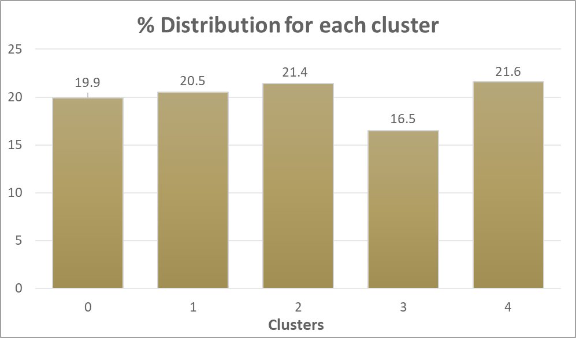
Relatively Uniform Distribution for Sahara 2
Cluster | Percentage
4 | 21.6%
2 | 21.4%
1 | 20.5%
0 | 19.9%
3 | 16.5%
Research
Clean
Build
Validate
Deploy
Notes:
Update confusion matrices

Slide 51
Decision Tree and Gradient Boost are Best Performing
Cluster 0
Cluster 2
Cluster 1
Cluster 4
Decision Tree
Decision Tree
Gradient Boost
Decision Tree
Confusion Matrix
1289638 | 17550
17647 | 308379
942252 | 17193
16911 | 331171
604412 | 22556
22813 | 309297
269352 | 6698
7007 | 343776
Accuracy*
97.8%
97.4%
95.26%
97.81%
Important Features
TV_Viewer 27.5%
SD_Employ 18.8%
LT_Gaming 67.4%
HW_Stress
49%
Outdoor_Grouping 71.8%
Research
Clean
Build
Validate
Deploy
Notes:
Update confusion matrices

Slide 52

Next Steps

Slide 53
How to Use Our Model
Obtain New Features from Clients
1
Clean and Prepare the Data
2
Use the Funnel Method to Predict
3
Select Best Model for Each Cluster
4
Utilize Targeted Marketing Efforts
5
Notes:
- Predict in order of distribution

Slide 54
Benefits of the Funnel Method
Data Filtering
Data Reduction
Improved Performance
Data is dropped from each cluster
Filter out irrelevant data early in the analysis process
Improved latency and bandwidth
Reduced amount of data that needs to be analyzed at each step
Low misclassification rates
Cleaner data inputs leads to better predictive accuracy
Interpretability
Scalability
Customization
Easily communicated and understood
Clear and transparent process for data analysis
Can be applied to large datasets
Systematic approach to handle large amounts of data
Each cluster is analyzed individually
The models can be fine-tuned and individualized for new data sets
Notes:
Shiv

Slide 55
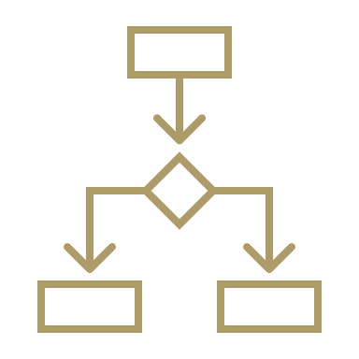


Limitations to the Funnel Method
Information Loss
Choosing Parameters
Black Box
Data is dropped from each cluster
May impact the accuracy and generalizability of subsequent cluster models
Resulting clusters may be biased towards certain types of features
Many parameters for many different model types
End-result is a complex hierarchy of clusters
Can be difficult for interpretation and understanding from all audiences
Mitigation
Mitigation
Mitigation
High accuracy score and low FNR
Trial & error of model types
Model explanation & simplification
Notes:
Shiv

Slide 56
Our Model will Increase Customer Lifetime Value
The Process
Obtain New Features from Clients
Predict New Segments
Understand Why the Segments are Different
Use Cases
Marketing &
E-Commerce
Targeted and personalized campaigns and messaging
Product Recommendations
Increased engagement and conversion rates
Customer
Lifetime Value
Optimize customer acquisitions and retention

Slide 57


Slide 58
Appendix

Slide 59
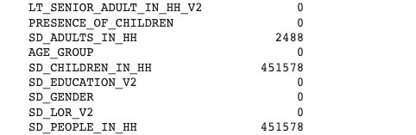
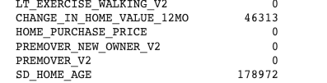
Data Cleaning

Slide 60
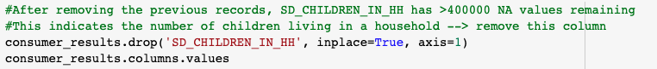
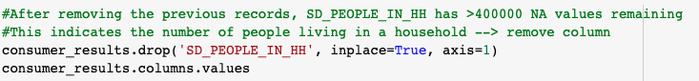
Data Cleaning

Slide 61
Age Charts

Slide 62
Ethnicity Charts

Slide 63
Ethnicity Charts

Slide 64
Income Charts

Slide 65
Income Charts

Slide 66
Education Charts

Slide 67
Education Charts

Slide 68
Gender Charts

Slide 69
Gender Charts

Slide 70
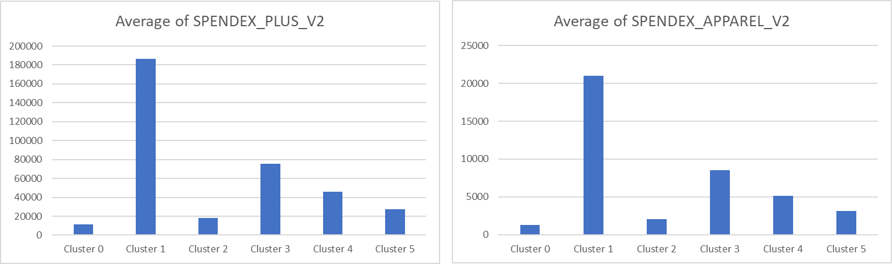
SPENDEX Charts

Slide 71
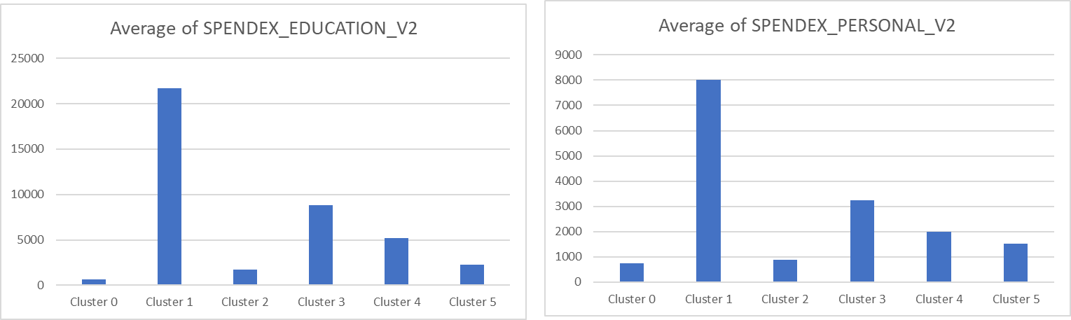
SPENDEX Charts

Slide 72
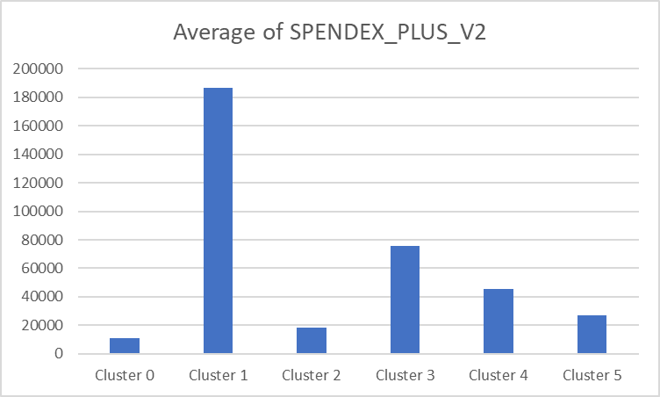
SPENDEX Charts

Slide 73
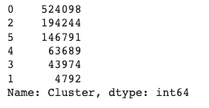
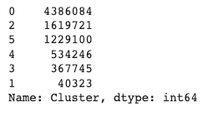
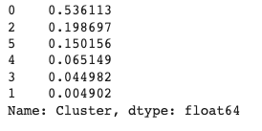
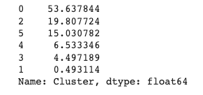
Sample vs. Entire Dataset
Sample Data Distribution
Entire Data Distribution

Slide 74
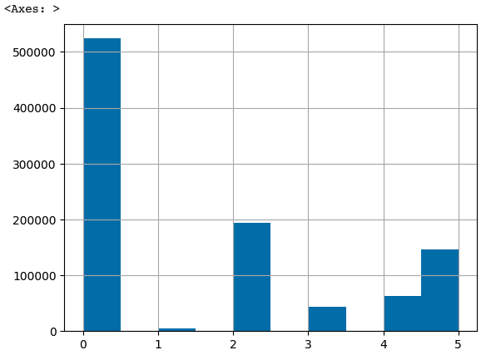
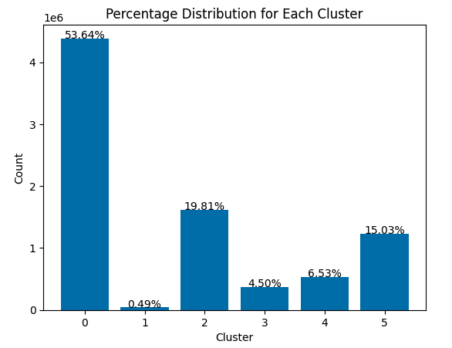
Sample vs. Entire Dataset
Sample Data Distribution
Entire Data Distribution

Slide 75
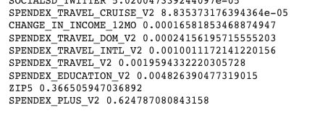
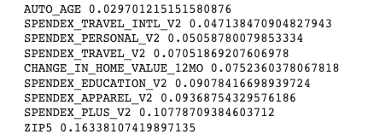
Importance Plots – Cluster 0
Cluster 0 Decision Tree
Cluster 0 Random Forest

Slide 76
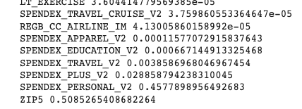
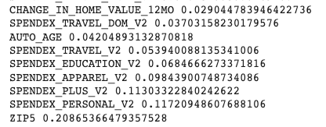
Importance Plots – Cluster 2
Cluster 2 Decision Tree
Cluster 2 Random Forest

Slide 77
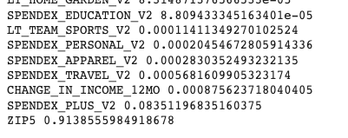
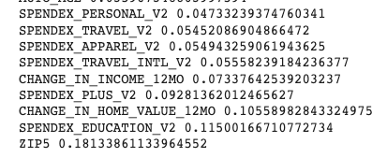
Importance Plots – Cluster 5
Cluster 5 Decision Tree
Cluster 5 Random Forest

Slide 78
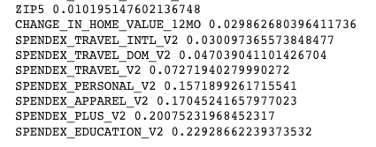
Importance Plots – Cluster 4
Cluster 4 Decision Tree
Cluster 4 Random Forest

Slide 79
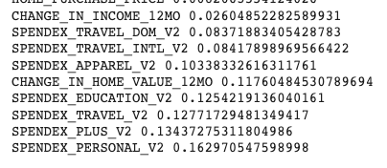
Importance Plots – Cluster 3
Cluster 3 Decision Tree
Cluster 3 Random Forest

